Slide 1
Communication Protocols & Standards
Pavan Malladi

Slide 2
In Mark Weiser’s vision of ubiquitous computing, computers disappear from conscious thought.
Four notable improvements in current hardware technology are
- Wireless Networking
- Processing Capabilities
- Storage Capacity
- High Quality Displays
Cell Phones, PDA are found as suitable replacement for the traditional computing.
This adoption requires common standards across many products and locales.

Slide 3
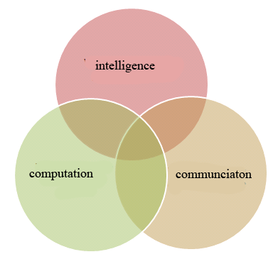
Emphasis on three circles

Slide 4
CELLULAR ARCHITECTURE
Cells
Clusters
Frequency Reuse
Cell splitting
Hand off

Slide 5
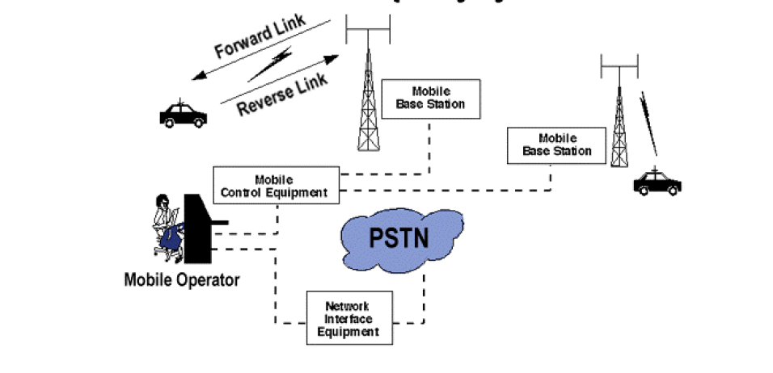
Mobile communications:

Slide 6
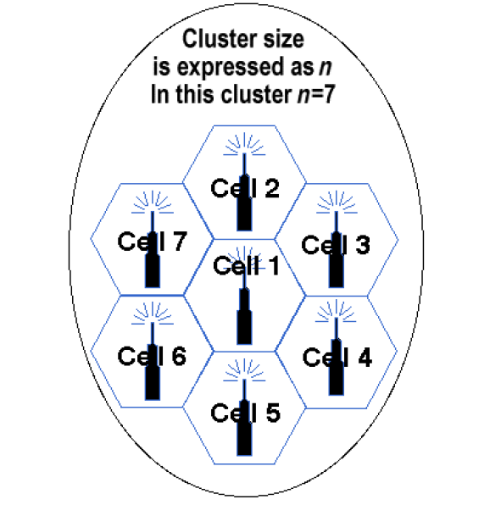
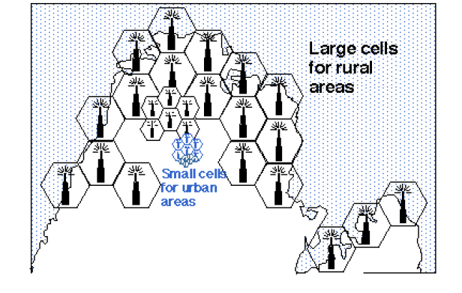
Cells & Clusters
Cells are basic geographical unit of a cellular system.
Landscape is divided in the shape of hexagon.
A cluster is a group of cells.
No channel is reused in the cluster.
clusters
Cell splitting

Slide 7
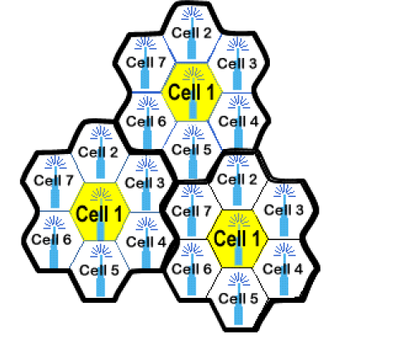
Frequency reuse

Slide 8
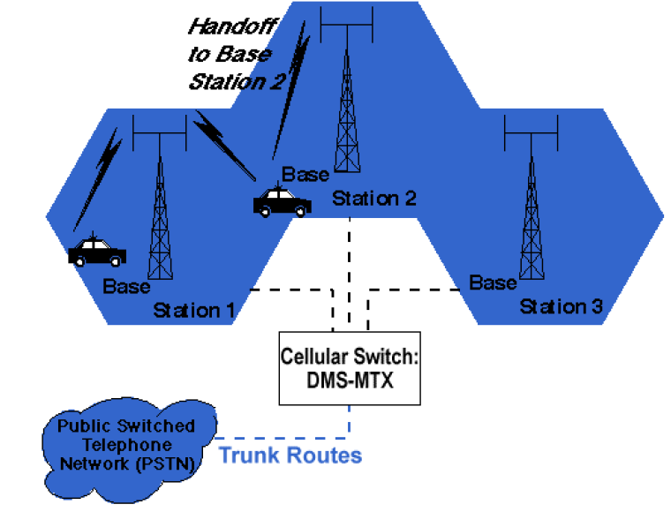
Hand off:
Occurs when the mobile moves from one cell to the adjacent cell.
Switches BST when frequency weakens.
User doesn’t notice the handoff.

Slide 9
Cell 1
Mobile
Telephone
Switching
Center
(MTSC)
Public
Switched
Telephone
Network
(PSTN)
HLR
VLR
Cell 2
Mobile User
Base Transceiver Station (BTS)
Cordless connection
HLR = Home Location Register
VLR = Visitor Location Register
Wired connection

Slide 10
Generations

Slide 11
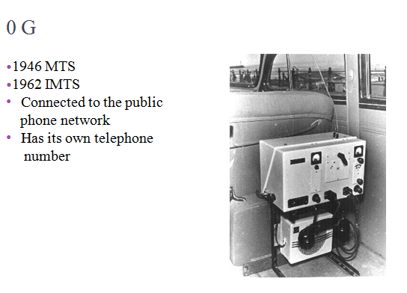

Slide 12
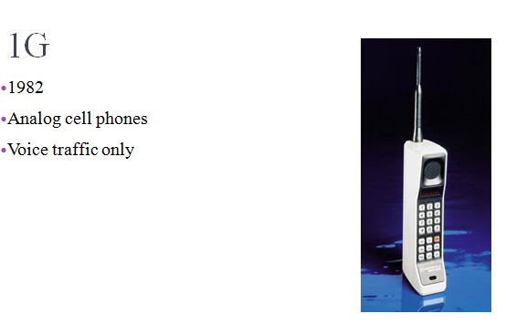

Slide 13
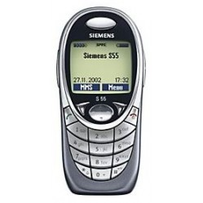
2G
1991
Digital Networks
SMS
1999 (2.5G)
GPRS
Data rate up to 128 kb/s
EDGE
Data rate up to 384 kb/s

Slide 14
GPRS:
General Packet Radio Service
Packet oriented mobile data service.
data transferred is charged per kilobytes unlike in GSM.
services:
-"Always on" internet access
- Multimedia messaging service (MMS)
- Instant messaging
-Internet applications for smart devices through WAP.
-Point-to-point (P2P) service: inter-networking with the Internet (IP)

Slide 15
EDGE:
Enhanced Data for global evolution
Increased data rates and reliablity-384 kbps
Making mobile Internet happen
Backward compatible
EDGE filling the gap between GPRS and 3G
Just an upgrade in base station subsystem is enough.
EDGE is used automatically when both the phone and network support it.

Slide 16
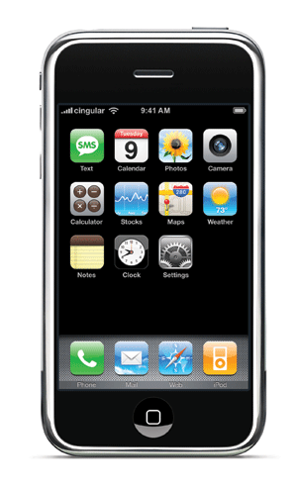
3G-vision
Common spectrum worldwide
– 1920-1980 MHz & 2110-2170 MHz
Data bit rates up to 2 Mb/s
Wide range of new services
– Data centric and multimedia
Seamless global roaming
Improved security and performance
Support a variety of terminal (from PDA to desktop)

Slide 17
HSPDA:
High speed Downlink Packet Access.
Improves downlink speed.
High Qos.
Speeds range from 1.8 Mbps to 14.4 Mbps.
Download high resolution images, multiplayer games etc.
Speeds may go up to 42 mbps.

Slide 18
4G
Expected in 2010
Mobile multimedia
Anytime anywhere
Global support
Integrated wireless solution
Customized personal service
Worldwide Interoperability for Microwave Access

Slide 19
WIMAX:
Problems with the present system.
WIMAX is the potential solution.
Provides universal Internet access.
Turning your computer on and connect to WiFi antenna.

Slide 20
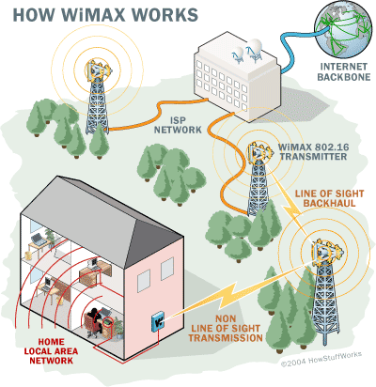
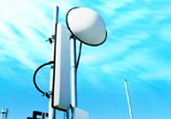
How it works:
TRANSMITTER:
- Similar to cell phone towers.
- covers an area of about 3,000 sq miles.
RECEIVER
- small antenna
- small box or built into a laptop.
Line of Sight.
Non-line-of-sight.
The proposal for GAN is IEEE 802.20
transmitter

Slide 21
Sends data via radio signals.
A computer receives encrypted data only.
Handle up to 70 Mbps.
It blanket a radius of 30 miles.
Deployment issues.
Consequences.

Slide 22
More bandwitdh, more possibilities
Technology | 1G | 2G | 2.5G | 3G | 4G
First design | 1970 | 1980 | 1985 | 1990 | 2000
Implementation | 1982 | 1991 | 1999 | 2002 | 2010?
Application | Analog voice | Digital voice, SMS | MMS, WAP | True internet, videocalling, mobile TV, high speed downloading | HD-TV streaming?
Standards | AMPS | TDMA, CDMA, GSM | GPRS, EDGE | EV-DO, W-CDMA, HSDPA | WiMAX, HSOPA
Data bandwidth | 1.9 kbps | 14.4 kbps | 384 kbps | 2 mbps | 200 mbps
Notes:
First, I am going to take another look at the table that Eveline just showed. I replaced the column ‘Service’ with a new column called ‘Application’. Here you can see the most common applications of the generation and it’s data standards. As the standard goes up, there is an increase in possibilities. We all know the GSM network, 2G, which made it possible to send short text messages. 2.5G had an higher bandwidth, making it possible to receive and send picture, video or audio messages through MMS. Also, it made WAP possible, WAP was the first form of internet on the mobile phones. Because of the available bandwidth, phone speed and the screen size, the internet pages had to be converted to suit the mobile phones. This conversion is done by WAP, however a page could only be visited if it also was available in WAP, if this wasn’t the case then viewing that page wasn’t possible. 3G gave mobile internet the speed it needed. With 2mbps it is very close to broadband internet speeds as we know it at home. In combination with the increase of capabilities of devices, think of a bigger screen and a faster cell phone, internet does not have to be converted anymore and applications like videocalling and file downloading are possible. The next step is 4G, with it’s very high speed it creates the possibility to view High Definition TV while being mobile.

Slide 23

RSS FEEDS:
It’s a form of web syndication.
Really Simple Syndication- an XML
based format for easily distributing
and aggregating the web content.
eg. Headlines, Web updates etc.
Aid in active filtering of ever growing
web content.
BBC, Amazon.com, Espn etc offer RSS feeds.

Slide 24
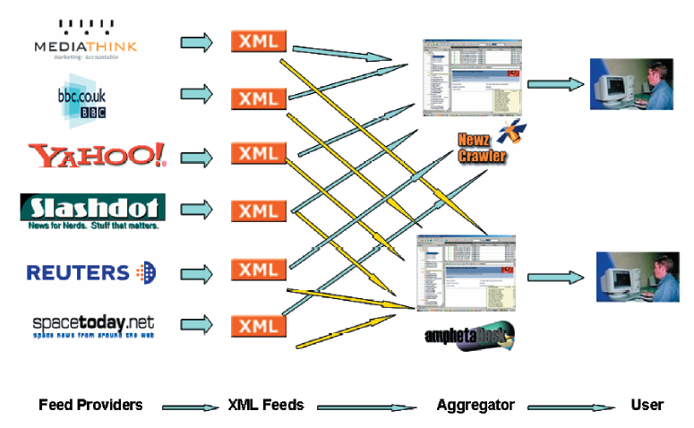

Slide 25
Advantages:
Fast updating by retrieving summaries of latest content.
Less time spent on surfing.
Personal information remains secured.
Can avoid unnecessary ads and menus etc.
Rich Media RSS- personal broadband channels.

Slide 26
Conclusion:
Many standards have been developed over past 10 years.
Band width is not a problem now.
Application that utilize the entire bandwidth must be developed.
Mobile internet must replace the fixed internet.
In 4G HDTV streaming must be made possible.

Slide 27
References:
www.wikipedia.org
www.iec.org
http://www.howstuffworks.com/wimax1.htm
A white paper on ‘Innovations of mobile communication standards and their applications for telecom companies’.
A paper on ‘Disappearing Hardware’ by Mark Weiser’
www.wimax.com
www.slideshare.com

Slide 28
Thank You

